Slide 1
Introduction to Arduino
Robotics Club

Slide 2
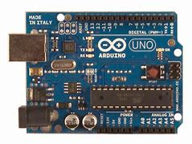
What is Arduino?
Micro controller
Kid-friendly programming hardware (for beginners).
Connects with Scratch software.
Basis of hardware

Slide 3
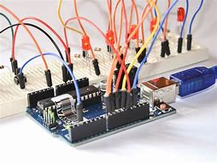
What can we do with Arduino?
Simple actions: light a LED light, make a light pattern, create sounds, read temperature, projecting messages, etc.
We will we doing these things using scratch mblock programming.

Slide 4
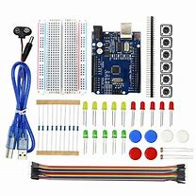
Components needed
Breadboard
LED
Jumper Wires
Arduino Board

Slide 5
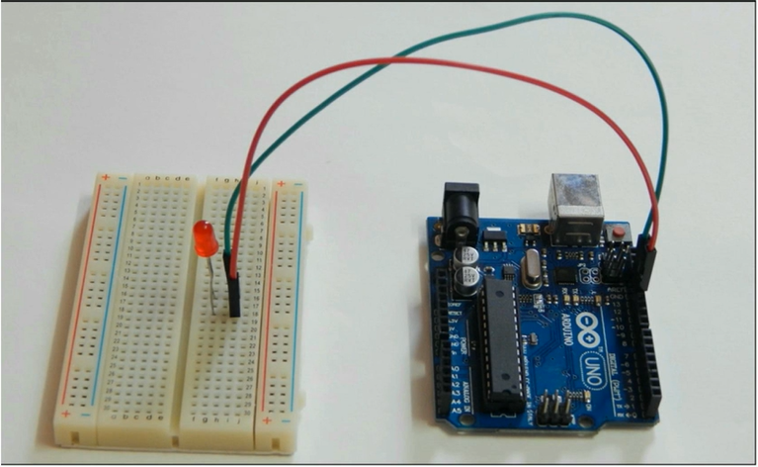
Turning an LED light on and off - hardware
Arduino board
LED light
Breadboard
Jumper Cable (2 for each light)
Follow the demonstration shown!

Slide 6
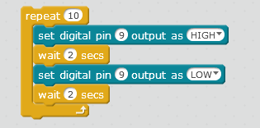
Turning an LED light on and off - software
Set digital pin output high → turn on LED
Set digital pin output low → turn off LED
Waiting 2 seconds will help in seeing the change

Slide 7
Make your own pattern!
Create a program to make this circuit:
Light the blue LED for 3 seconds, turn it off, and light the red LED for 2 seconds.

